Slide 1
Nuveen Sales Team Optimization
Kathryn Doorley, Matthew Houde, Wilson Dong, Eric Zhang, Edmilson Da Moura

Slide 2
Background
Nuveen is an asset manager with over $1.2 trillion in AUM (assets under management). Nuveen sells investment funds, such as Mutual funds (MF), Closed-end funds (CEF), Exchange-traded funds (ETF) and Separately-managed accounts (SMA), and it “wholesales” its products to Investment Professions, sometimes referred to as Advisors or IPs for short.

Slide 3
Objective
Nuuvem is looking to optimize their sales teams. The sales teams will divide clients up based on low, medium and high value indicators. By using a predictive model, we looked to easily classify clients into these three categories.

Slide 4
Binning Process
We chose to create bins from each client’s AUM balance. To create the client bins of low, medium and high we used percentages to classify these groups.
The ‘low’ bin has the lowest 33% of clients
The ‘medium’ bin has the clients between 33% and 66%
The ‘high’ bin has the highest 33% of clients.

Slide 5
Model Details
Dependent Variable Used: Client Value (measured by AUM bins)
Independent Variables Used: 'no_of_sales_12M_1', 'no_of_Redemption_12M_1', ‘no_of_sales_12M_10K', 'no_of_Redemption_12M_10K', 'no_of_funds_sold_12M_1', 'no_of_funds_redeemed_12M_1', 'no_of_fund_sales_12M_10K', 'no_of_funds_Redemption_12M_10K', 'no_of_assetclass_sold_12M_1', 'no_of_assetclass_redeemed_12M_1', 'no_of_assetclass_sales_12M_10K', 'no_of_assetclass_Redemption_12M_10K', 'No_of_fund_curr', 'No_of_asset_curr', ‘'sales_curr', 'sales_12M','redemption_curr', 'redemption_12M', 'new _Fund_added_12M', 'redemption_rate', 'aum_AC_EQUITY', 'aum_AC_FIXED_INCOME_MUNI', 'aum_AC_FIXED_INCOME_TAXABLE', 'aum_AC_MONEY', 'aum_AC_MULTIPLE', 'aum_AC_PHYSICAL_COMMODITY', 'aum_AC_REAL_ESTATE', 'aum_AC_TARGET', 'aum_P_529', 'aum_P_ALT', 'aum_P_CEF', 'aum_P_ETF', 'aum_P_MF', 'aum_P_SMA', 'aum_P_UCITS', 'aum_P_UIT'

Slide 6
Model Type
Random Forest
Gradient Boosting
Decision Tree
Linear Regression

Slide 7
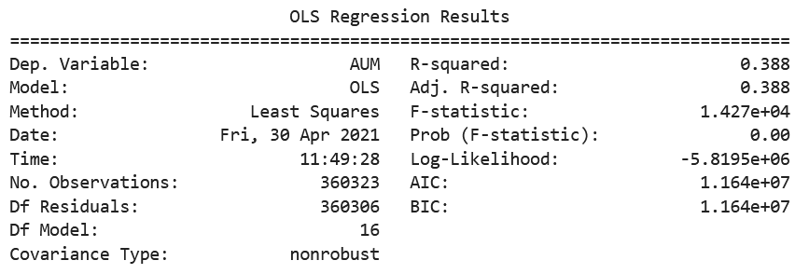
Model Accuracy
Random Forest Accuracy: 78.1%
Gradient Boosting Accuracy: 70.9%
Decision Tree Accuracy: 77.2%
Linear Regression AUM: R-Squared 0.388

Slide 8
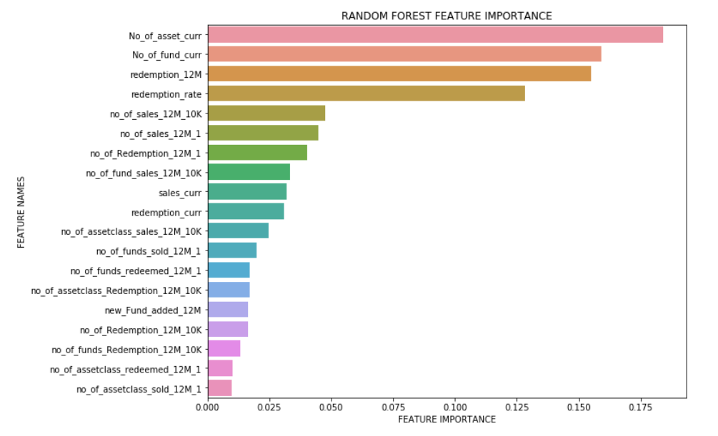
Random Forest Feature Importance

Slide 9
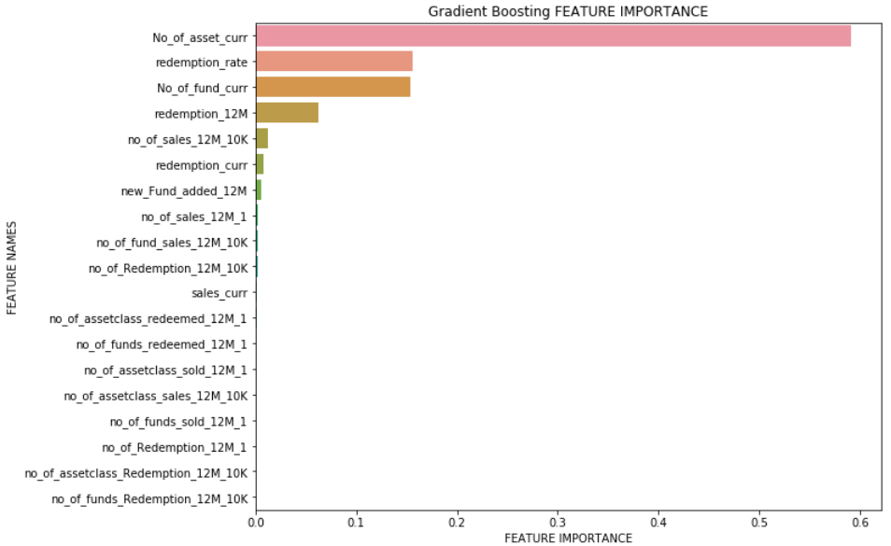
Gradient Boosting Feature Importance

Slide 10
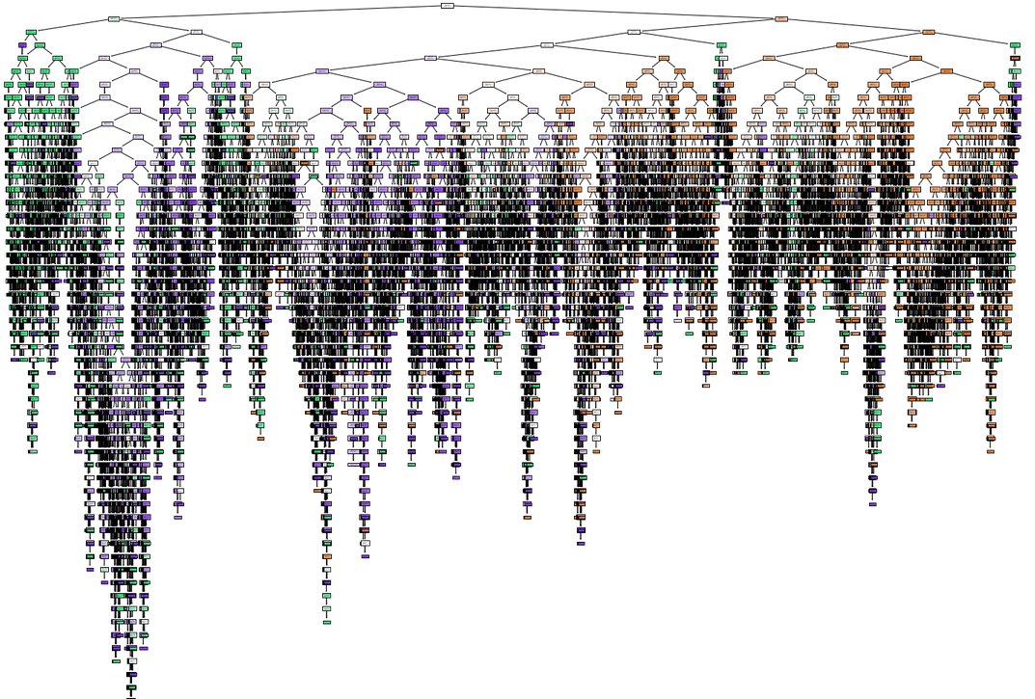
Decision Tree

Slide 11
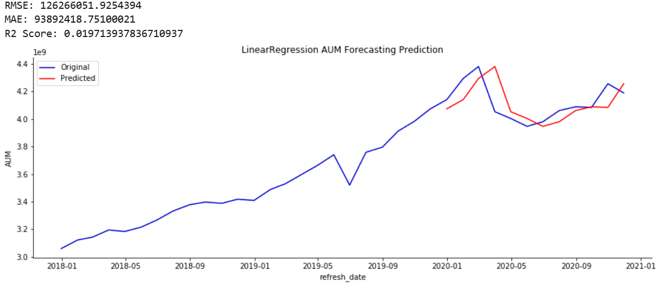
AUM Prediction (Linear Regression Based)

Slide 12
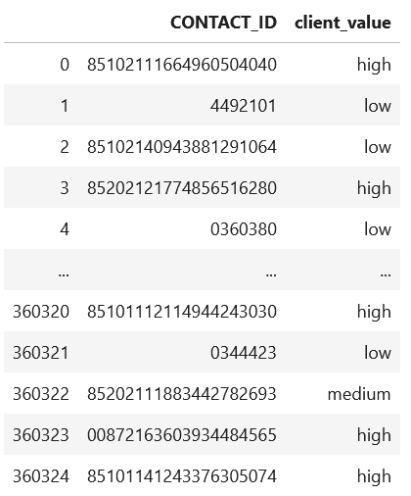
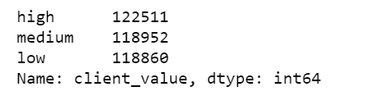
Recommendations
Based on each client’s AUM record, the client values are determined from the bin with a range in between the minimum and maximum AUM value. Each client’s client value is listed and assigned next to their contact ID.

Slide 13
Thank You, Any Questions?

